Slide 1
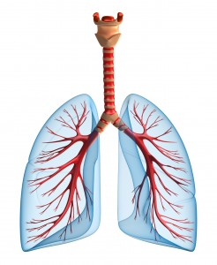
RESPIRATORY SYSTEM

Slide 2
Identify the following.
1. Hair that traps dust
ILACI

Slide 3
2. TISSUE THAT
PREVENT FOOD
FROM ENTERING
THE LUNGS
LOTITEPIGS

Slide 4
3. GLAND THAT
PRODUCE MUCUS
LANAS VICATY

Slide 5
4. PASSAGEWAY OF
FOOD, WATER AND
AIR
ARPYHNX

Slide 6
5. CONNECT
BRONCHI
AND VOICE BOX
TEARACH

Slide 7
6. CONTAINS VOCAL
CORDS
IVOCE OBX

Slide 8
7. MUSCLE THAT
PUSH OR PULL THE
LUNGS
RAGDIAPHM

Slide 9
8. CARRY AIR TO
THE LUNGS
BORNICH

Slide 10
9. CONNECT
BRONCHI TO
ALVEOLI
LEBROCHISNO

Slide 11
10. WHERE OXYGEN
AND CARBON
DIOXIDE EXCHAGE
TAKE PLACE
ALIVEOL

Slide 13
Identify the following.
1. PASSAGEWAY OF
FOOD, WATER AND
AIR

Slide 14
2. Hair that traps dust

Slide 15
3. GLAND THAT
PRODUCE MUCUS

Slide 16
4. CONNECT
BRONCHI
AND VOICE BOX

Slide 17
5. MUSCLE THAT
PUSH OR PULL THE
LUNGS

Slide 18
6. CONTAINS VOCAL
CORDS

Slide 19
7. CARRY AIR TO
THE LUNGS

Slide 20
8. CONNECT
BRONCHI TO
ALVEOLI

Slide 21
9. WHERE OXYGEN
AND CARBON
DIOXIDE EXCHAGE
TAKE PLACE

Slide 22
10. TISSUE THAT
PREVENT FOOD
FROM ENTERING
THE LUNGS

