Slide 1
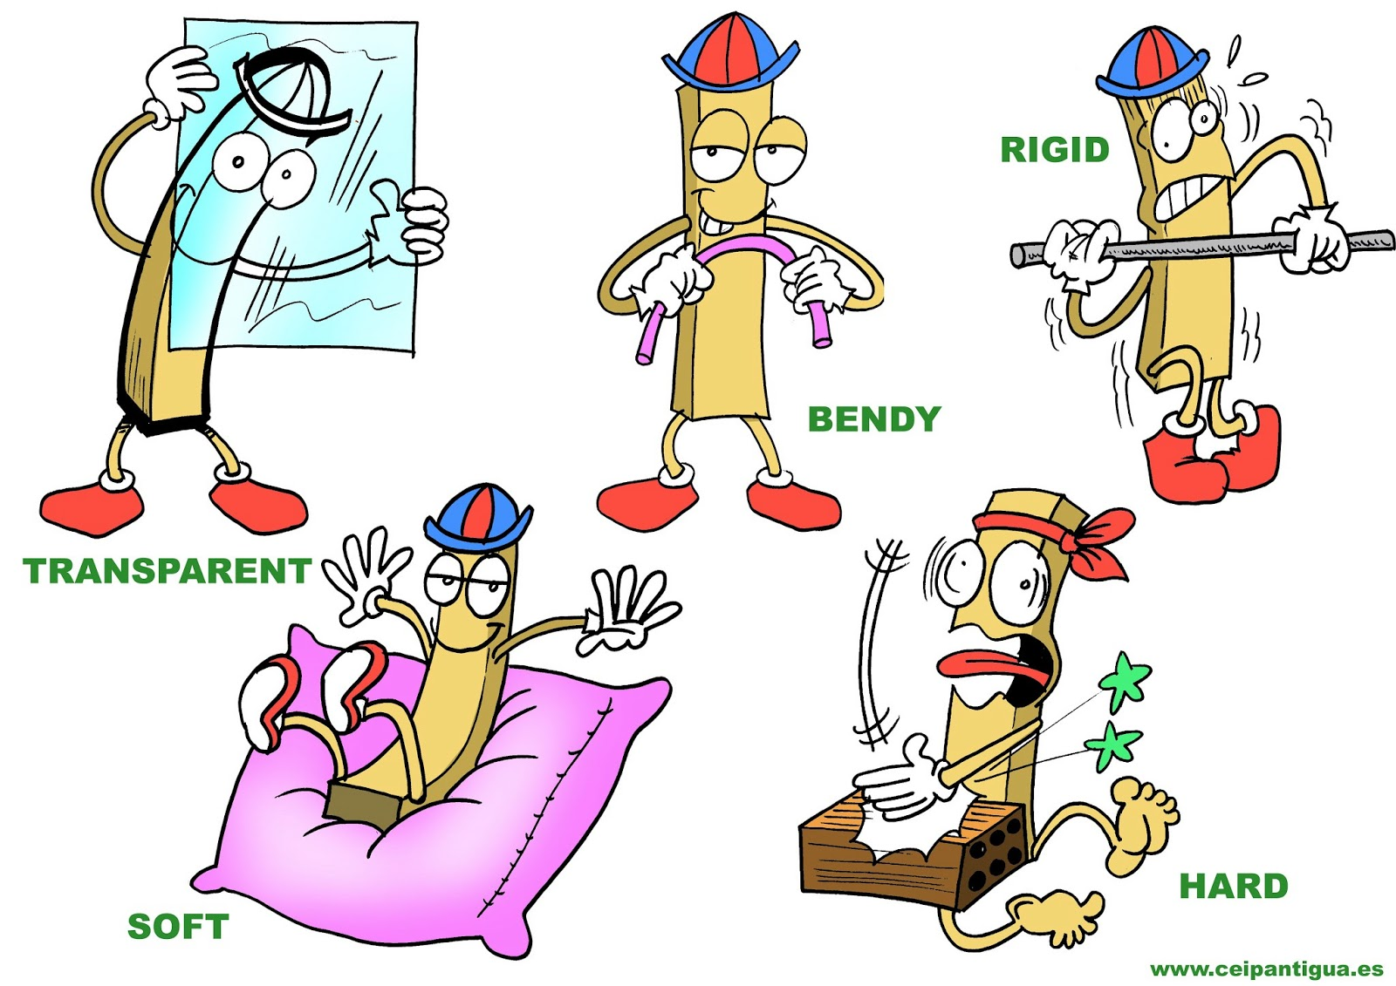
PROPERTIES OF MATERIALS

Slide 2
I. Identify the ff. property
1. Allow light to pass through
TRANSPARENT OPAQUE

Slide 3
2. Allow heat or electricity to pass through
Insulator Conductor

Slide 4
3. Ability to be stretched
Elastic flexible

Slide 5
4. Do not absorb water
Waterproof
Water absorbent

Slide 6
5. Do not allow heat or electricity to pass through
Insulator Conductor

Slide 7
II. Identify the property of the ff. materials. Refer to the words below. ANSWERS
MAY BE REPEATED.

Slide 8
WATERPROOF TRANSPARENT
ELASTIC LIGHT
FLEXIBLE HARD
INSULATOR CONDUCTOR
WATER ABSORBENT

Slide 9
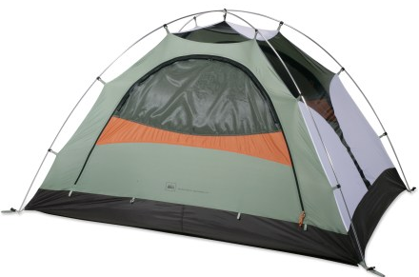
1. Tent pole

Slide 10
2. Outer cover

Slide 11
3. Peg

Slide 12
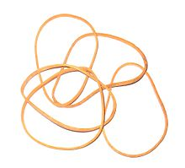
4. Rubber band

Slide 13
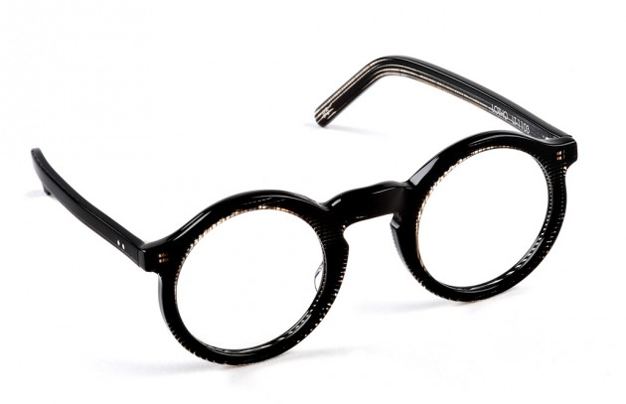
5. Eyeglass

Slide 14
6. Eyeglass

Slide 15
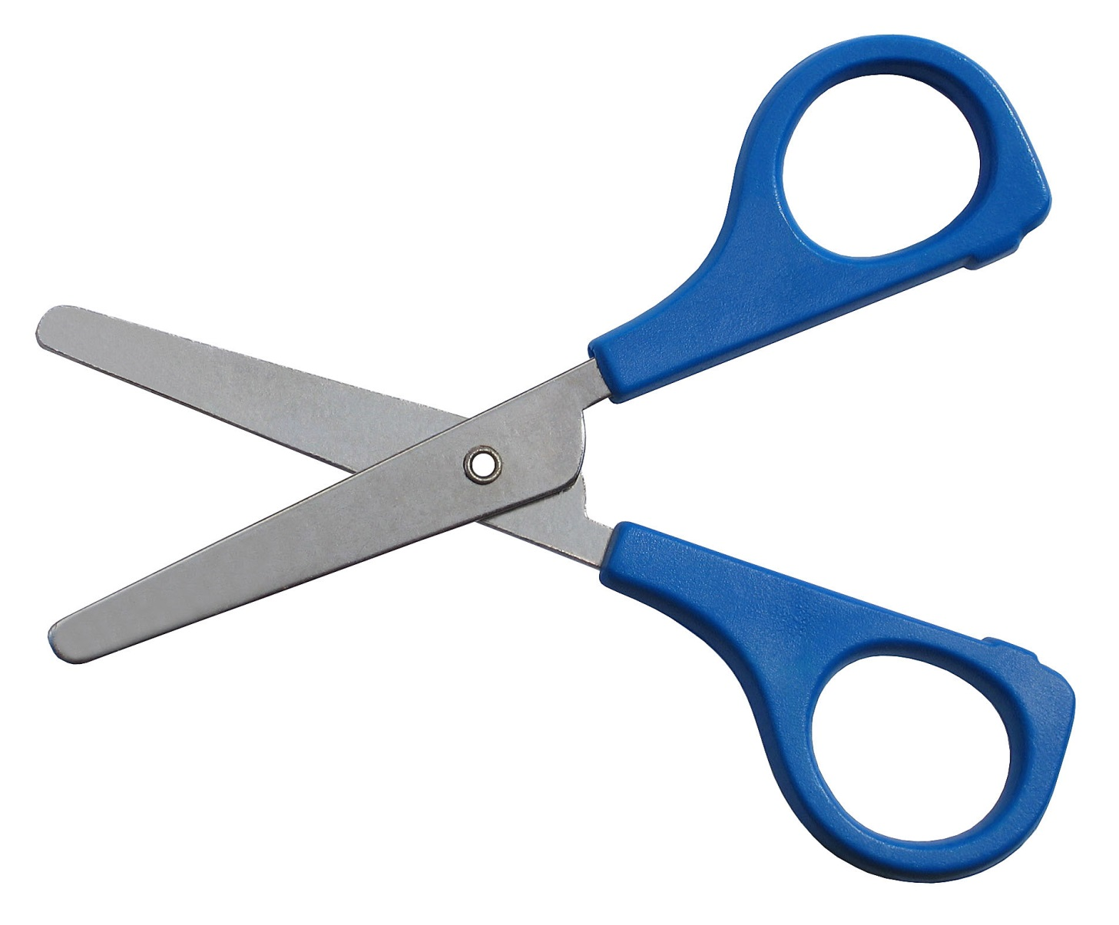
7. Scissors

Slide 16
8. Scissors

Slide 17
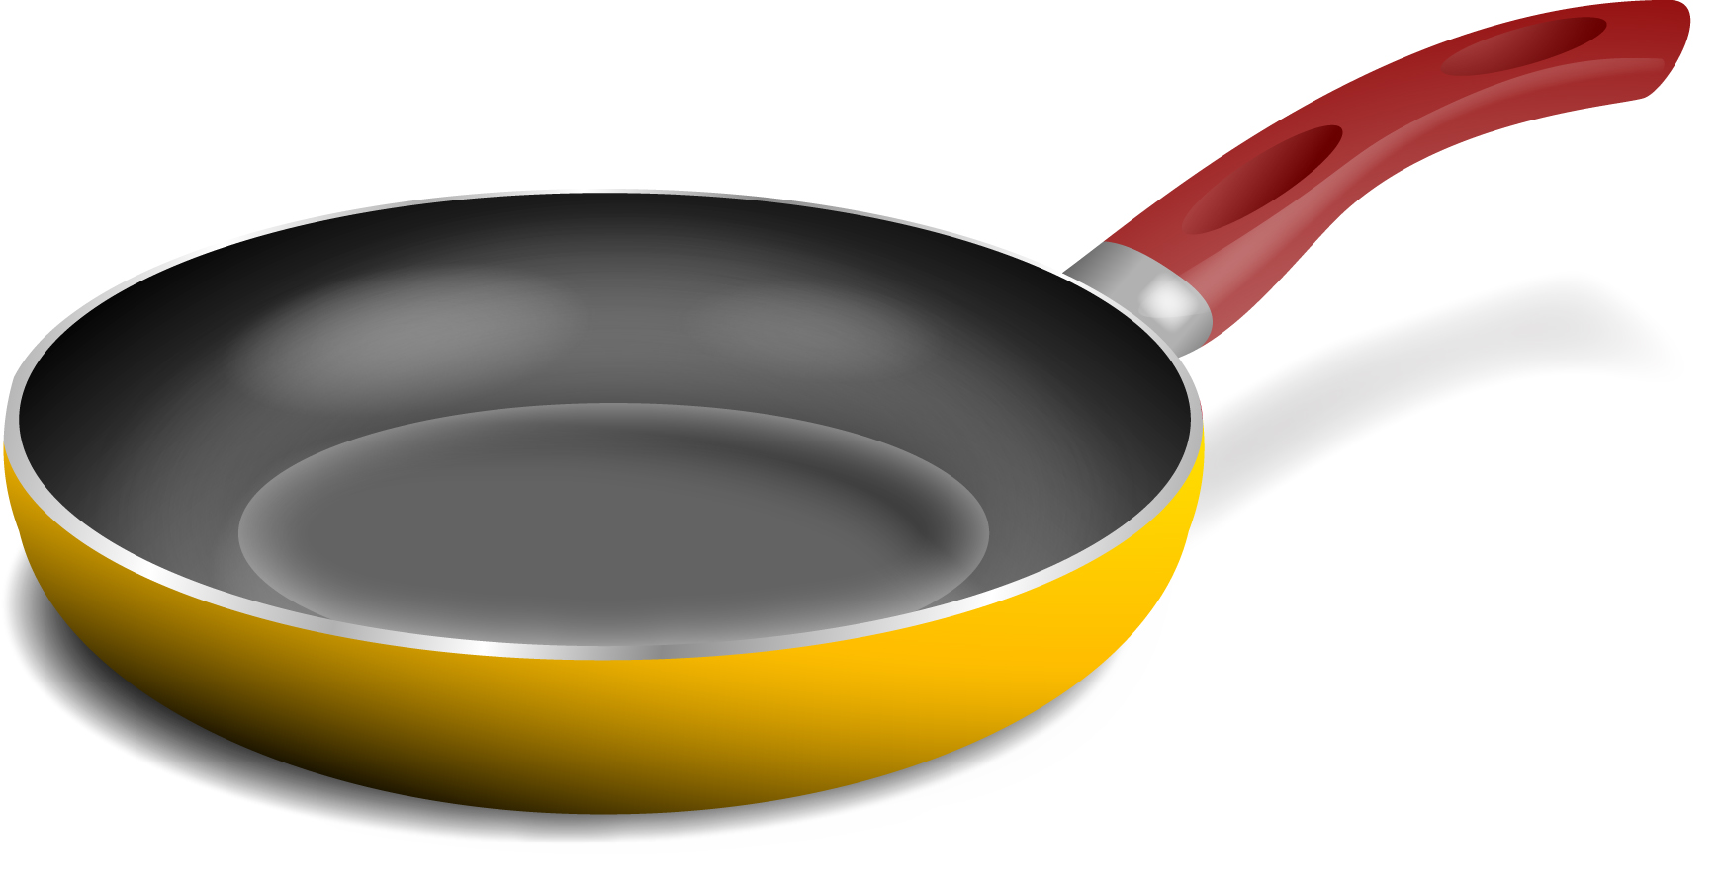
9. Frying pan

Slide 18
10. Frying pan

Slide 19
III. List down five materials that you will use to build a mobile catapult for

Slide 20
Huge, fat and heavy pig

